Slide 1

Introduction to the College of Engineering (COE) Computer labs

Slide 2
What is your COE account
Your College of Engineering account (COE) is what you use to login to all College of Engineering computer labs.
It is NOT the same as your UCSBNetID
Different levels provide access to different locations and resources
CS does not have a separate account, but does have extra attributes that can be added to your CoE account.
UCSBnetID, Umail, campus level labs and software like the VPN
UCSB
COE accounts, COE labs and COE software
COE
Other colleges
Departmental labs and departmental software
ECE
May not apply to all departments
Non-COE Departments

Slide 3
What is your COE account
Your College of Engineering account (COE) is what you use to login to all College of Engineering computer labs.
It is NOT the same as your UCSBNetID and can have a completely separate username and password.
Only people actively taking classes or otherwise associated with the College of Engineering are eligible for accounts.
If you have previously had a COE account, your account will be activated when you are enrolled in classes.
For new students, there is a time lag between when you sign up for classes and when your COE account creation invite will be ready.
If you have not already done so, please create your College of Engineering account at: https://accounts.engr.ucsb.edu/create

Slide 4
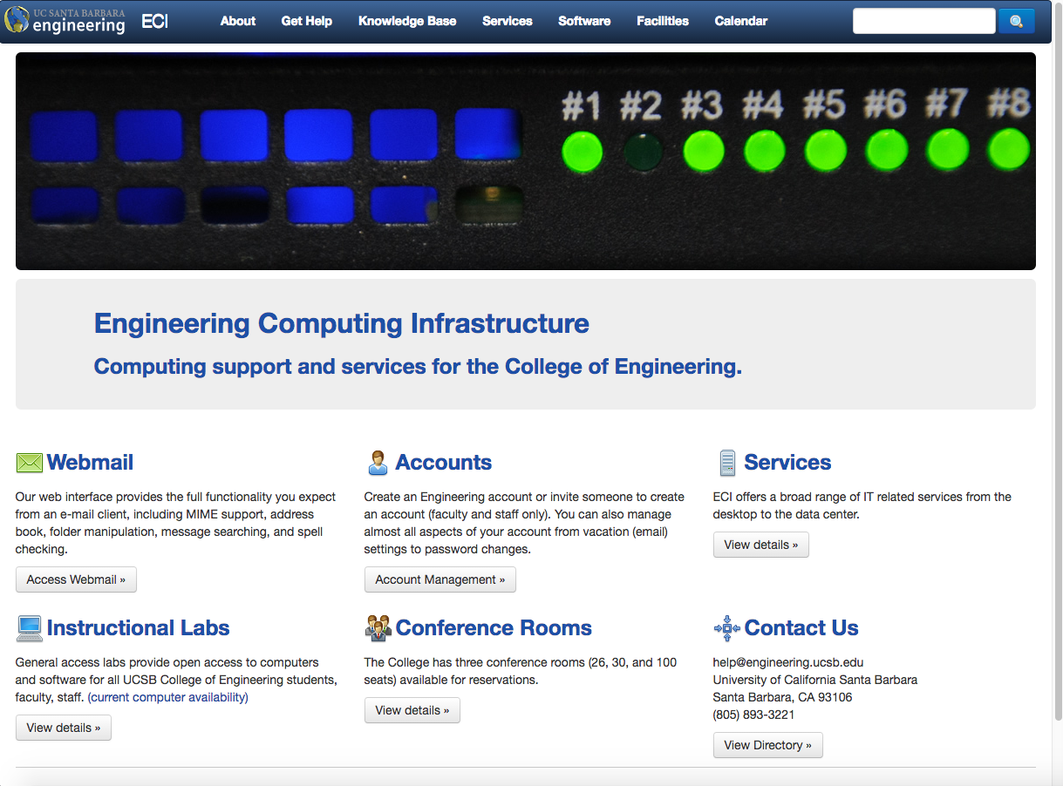
What is Engineering Computer Infrastructure (ECI)
We are the system administrators and support personnel for the College of Engineering. We make sure your wired network is working, that your lab computers run, and provide software and support. You can email us at: help@engineering.ucsb.edu
We are not in charge of facilities, cleaning, or helping you with your homework. All Homework questions will be directed back to TAs
Check out our knowledge base: https://eci.ucsb.edu/eci/kb

Slide 5
Online Access
You can access all our computer systems remotely
All Linux systems have identical software. All Windows systems have identical software.
Please note that Windows systems do not have mounted home directories, so please save all your work to google shared drives or samba shares to avoid data loss.
A connection to the Campus "Pulse Secure" VPN Service is required to make remote desktop connections to our computing labs. This uses your UCSBnetID
In addition, you will need to authenticate on the remote lab computer using your College of Engineering account.
https://doc.engr.ucsb.edu/display/EPK/Remote+Access+to+Computer+Science+Computing+Labs

Slide 6
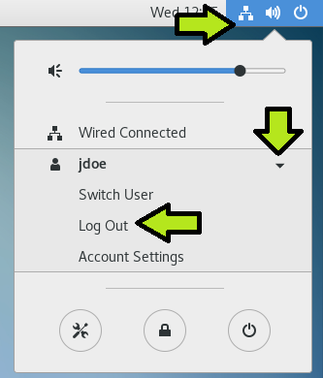
How to login/logout
Login is your COE username and password
NO @engineering.ucsb.edu required
  i.e username: John_Doe password: Changeme123
To logout, click the arrow/person icon, then click your username, then logout
Please do not shutoff/unplug the computers, that is not how to logout of a computer.

Slide 7
Why is it important to Logout?
Not logging out will cause problems like:
  Files being left open. This may make it difficult to work with your file. Some programs will not allow you to open and/or save because the file is already open somewhere else
  Web Browsers not closed properly. Browsers may say that it is already running, even though it is not on your current computer
  If you do not logout, other people may be able to access and modify your work .

Slide 8
Special Notes:
Linux computers are networked. If you save your work on your account, you will be able to access your work from any CSIL, LInux, or CSTL designated computers.
If you are using the terminal; Your account is any path that starts with ~/ or after /cs/student/<username>
If you save your work anywhere else, do not be surprised when it is not there the next day. Work that is saved locally may be erased at the end of the day
Be sure to logout when you leave. If you do not logout, you may have “You are already logged into another computer” errors next time you try to login.
There is currently no printing available due to Covid.

Slide 9
Quotas
All accounts have a set amount of space allocated and a maximum number of files. This is called a quota.
We have quotas because all network accounts use shared disk space and due to bandwidth limitations.
Standard quota on Linux computers is 6Gb
If you need more space, you can make use of Google Drive via UCSB Connect which uses your UCSBnetID.

